Slide 1
Lecture 4
Op Amp – Part 2

Slide 2
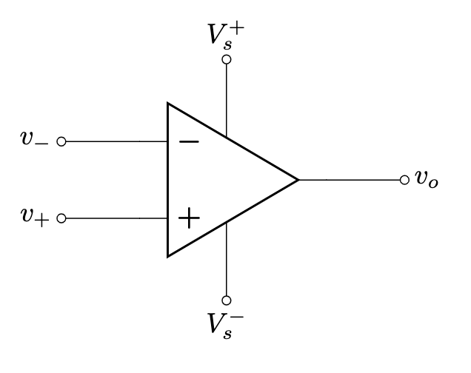
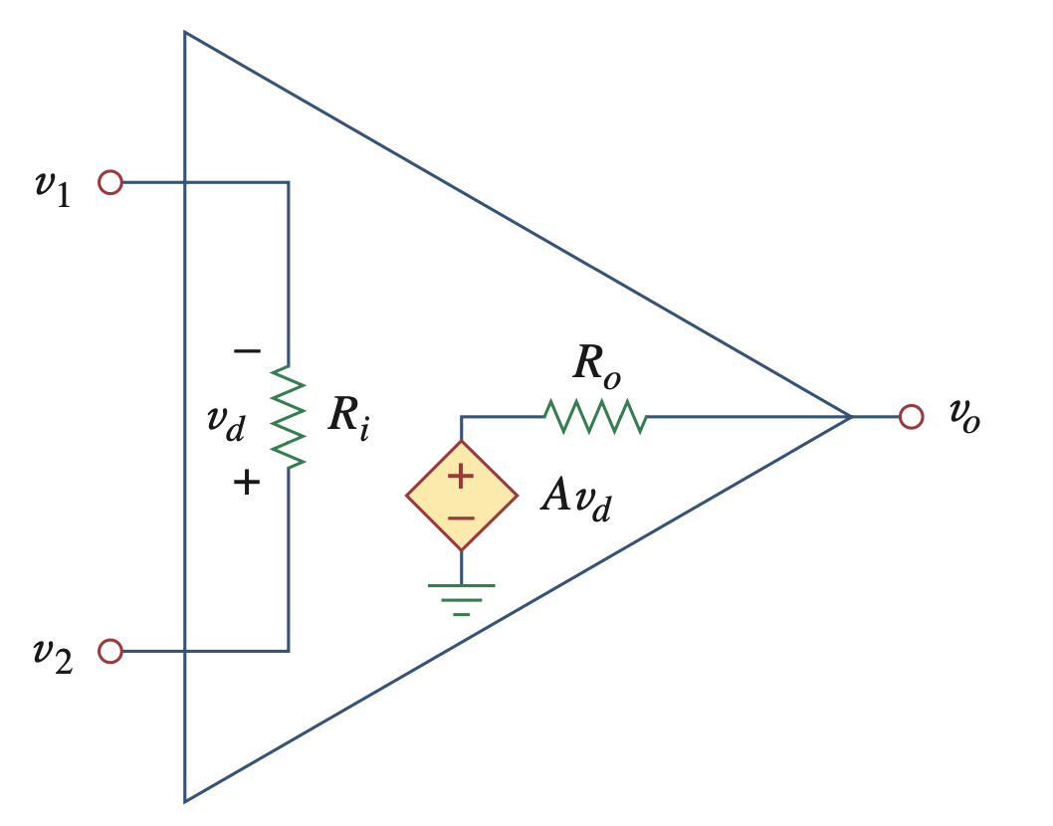




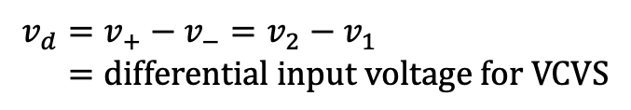

Review – Operational Amplifier
$$v_{1}=v_{−}=voltage of inverting terminal$$
$$v_{2}=v_{+}=voltage of noninverting terminal$$
$$v_{d}=v_{+}−v_{−}=v_{2}−v_{1} \\ =differential input voltage for VCVS$$
$$A=Open loop gain$$
$$R_{i}=Input resistance$$
$$R_{o}=Output resistance$$
Differential amplifier $⇒$ amplifies the difference
$$v_{o}=Av_{d}=A\left(v_{2}−v_{1}\right)=A(v_{+}−v_{−})$$

Slide 3
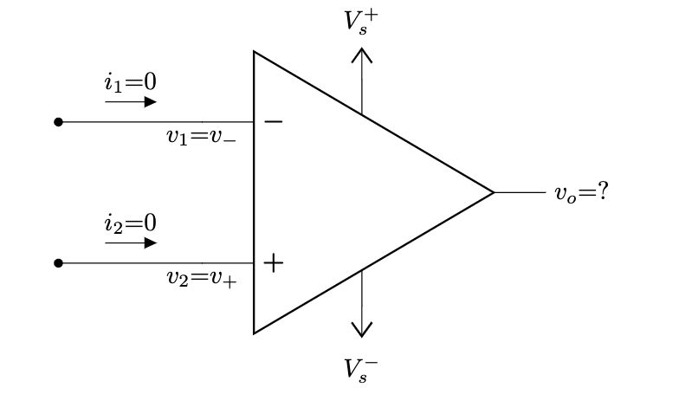
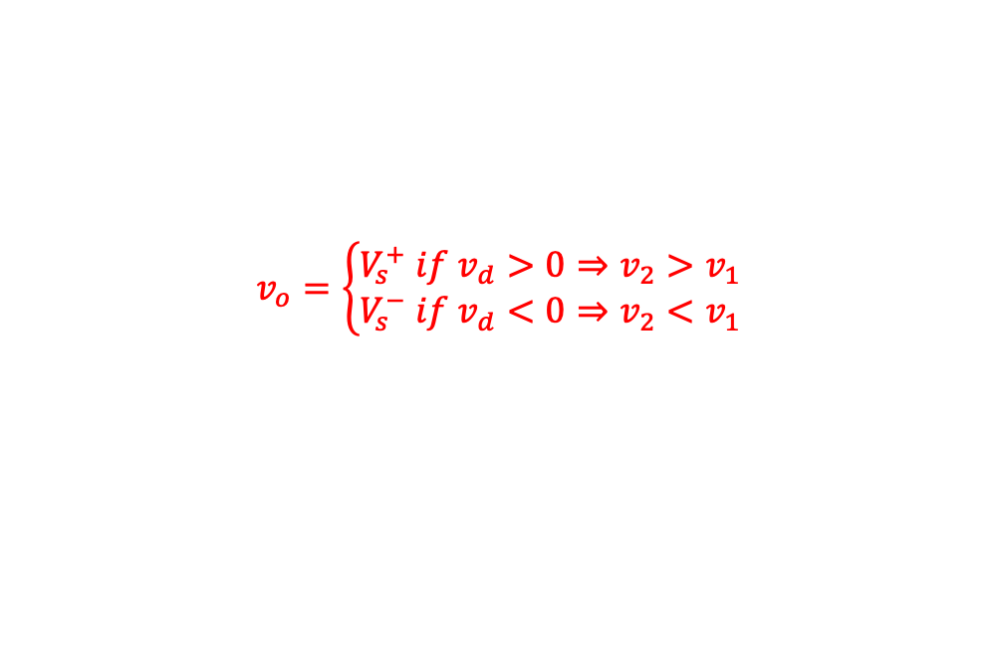




Review – Ideal Op Amp
Infinite open-loop gain, $A=∞$
Infinite input resistance, $R_{i}=∞=open circuit$
Zero output resistance, $R_{o}=0=short circuit$
As $R_{i}=∞$ (open circuit), $i_{1}=i_{2}=0$. Therefore, circuit solving become much simpler
$$V_{s}^{+}$$
$$v_{o}=\left\{\begin{aligned}V_{s}^{+} if v_{d}>0⇒v_{2}>v_{1} \\ V_{s}^{−} if v_{d}<0⇒v_{2}<v_{1}\end{aligned}\right.$$
$$v_{d}$$
$$V_{s}^{−}$$
VTC of ideal op amp

Slide 4
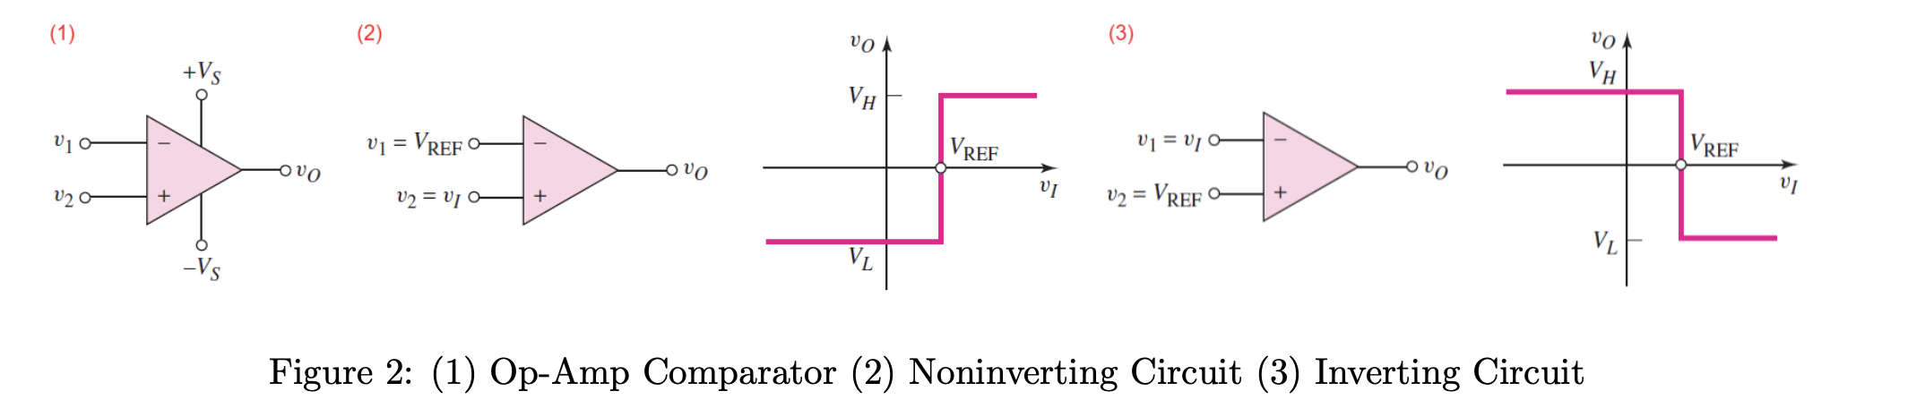


Application of Ideal Op Amp - Comparator
A comparator compares two voltages to determine which is larger.
The comparator is essentially an op-amp operated in an open-loop configuration
Two types –
(1) Non-inverting: outputs a positive voltage ($V_{H}=V_{s}^{+}$) when input is greater than reference
(2) Inverting: outputs a negative voltage ($V_{L}=V_{s}^{−}$) when input is greater than reference
Application – smoke detector, turning AC on/off automatically, etc

Slide 5
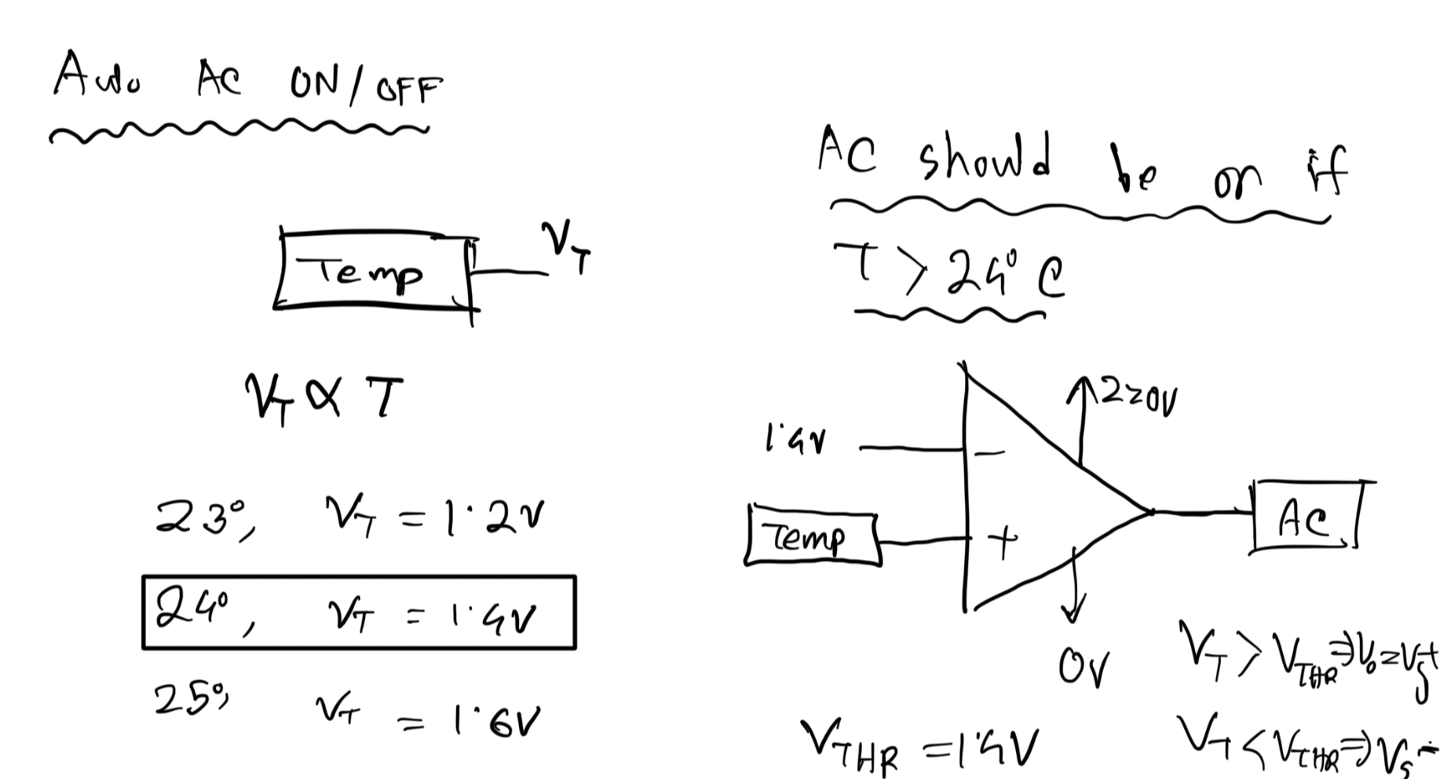
Comparator Application – Automatic AC
Sensor
Sensor

Slide 6
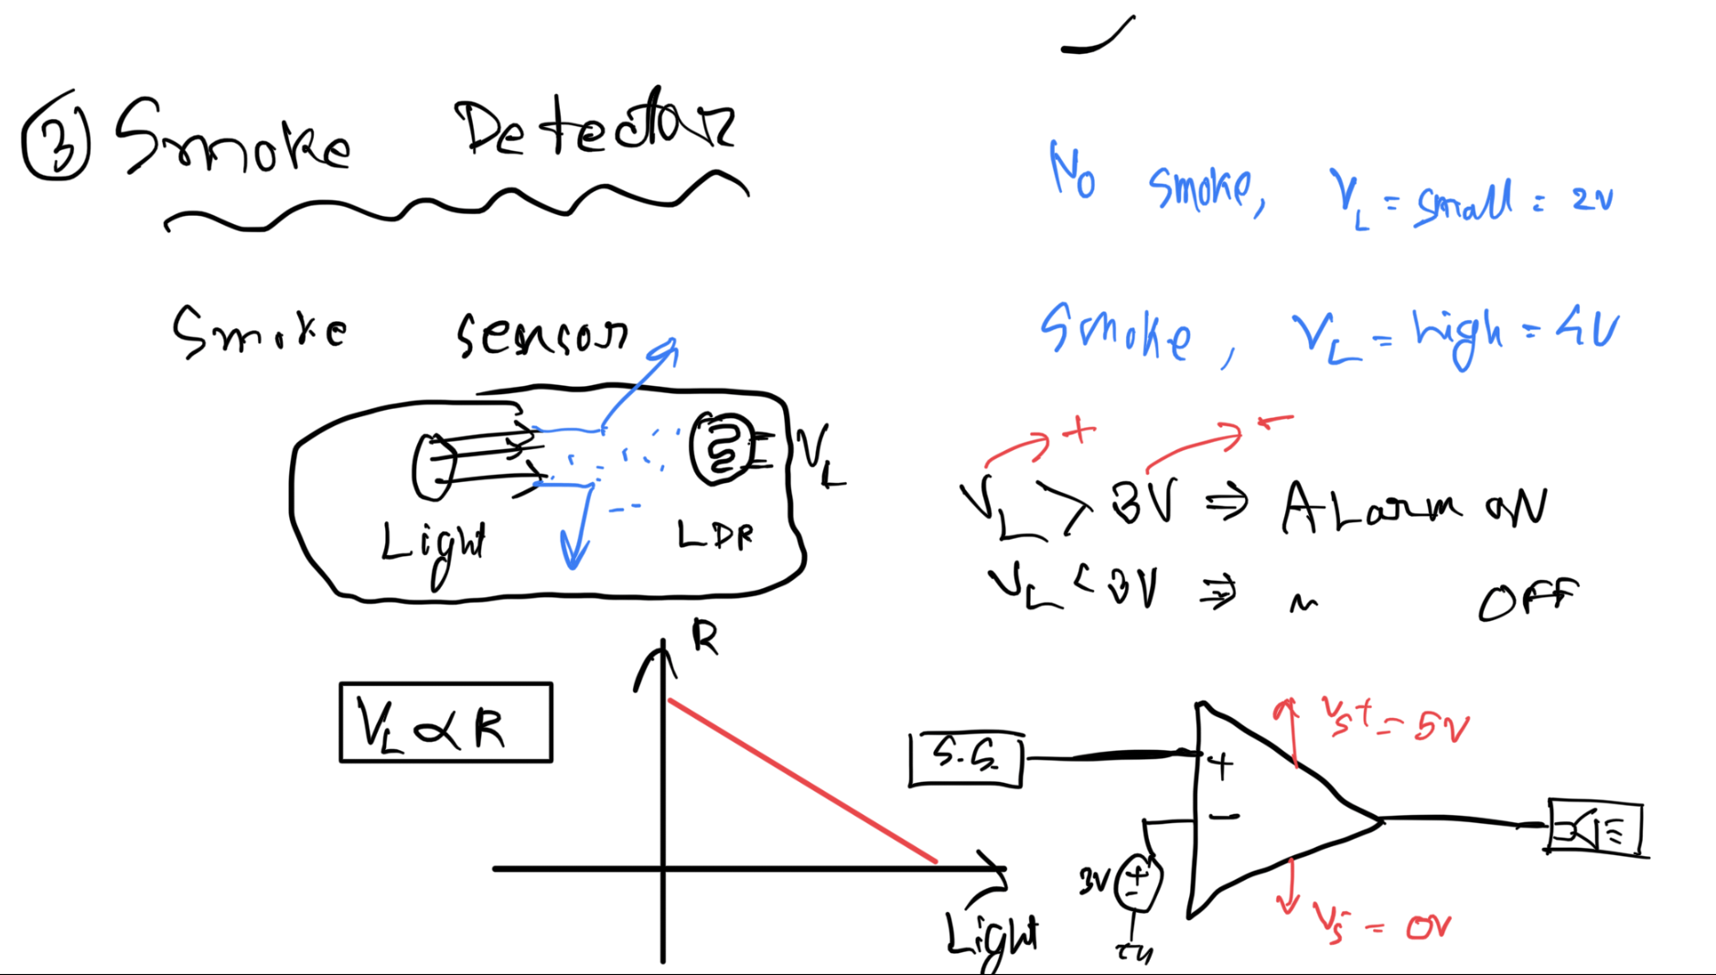
Smoke Detector

Slide 7
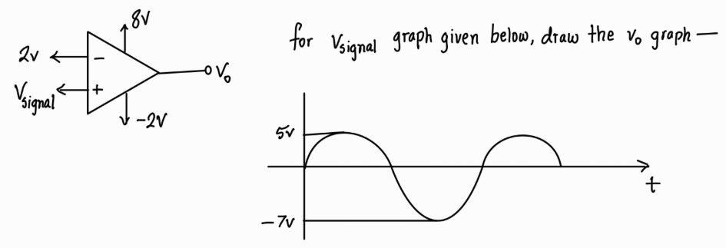
Comparator Example

Slide 8
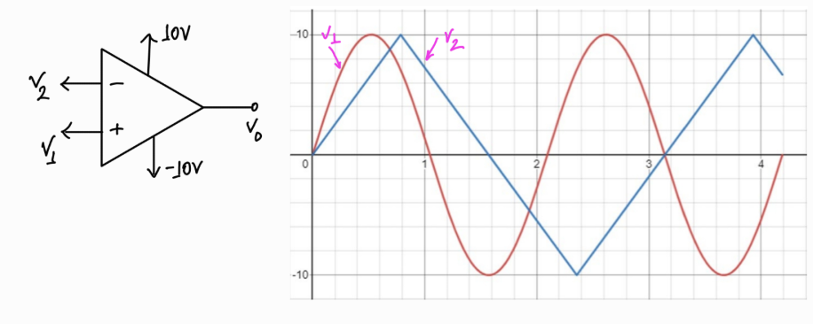
Comparator Example

Slide 9
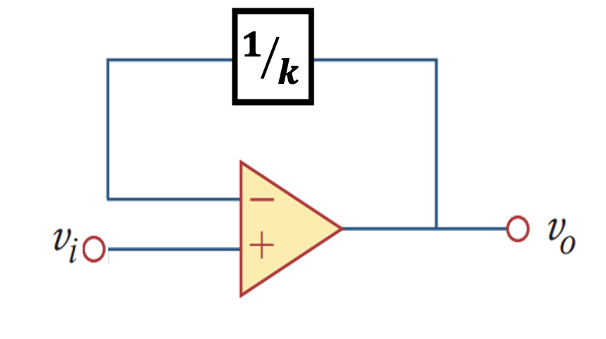

Introducing Negative Feedback
The gain (A) of an ideal op amp is infinity, practically extremely large.
The power supply (+Vs and –Vs) limits the op amp's output.
We require a method to have a finite gain. That is what negative feedback does.
Negative feedback: feeding back a portion of output to inverting input
Idea – the output will become stable due to a self-correcting mechanism
For example, her, $v_{−}=one k^{′}th part of ouput=\frac{1}{k}$
If $v_{o}$ increases, $v_{−}$ will increase, hence $v_{d}$ will decrease, eventtually $v_{o}$ decreases
If $v_{o}$ decreases, $v_{−}$ will decrease, hence $v_{d}$ will increase, eventtually $v_{o}$ increase

Slide 10
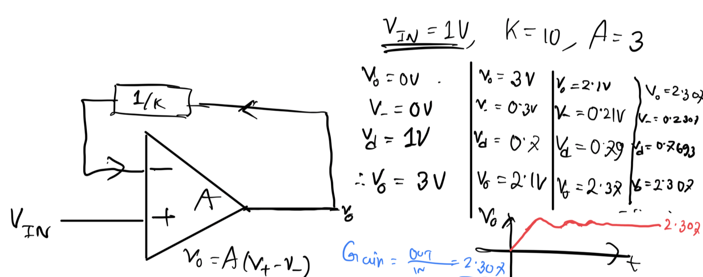
Negative Feedback – Numerical Example
Notes:
2.3 dile 2.89

Slide 11
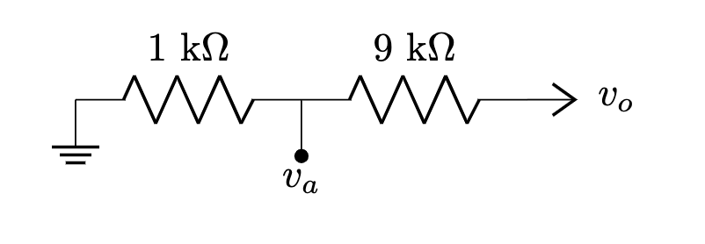
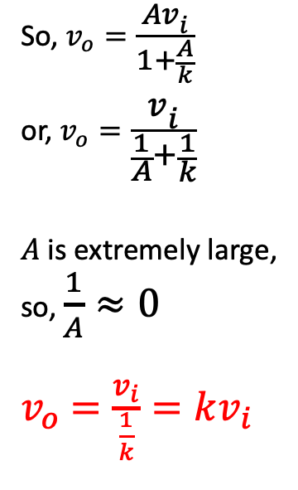
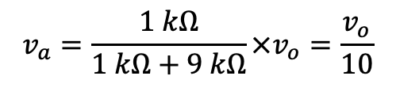
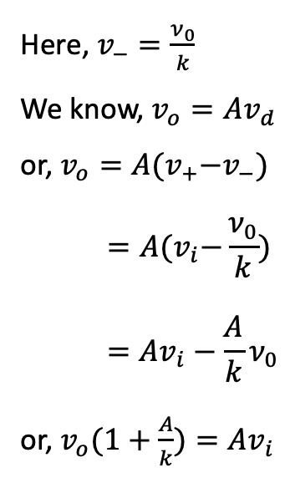
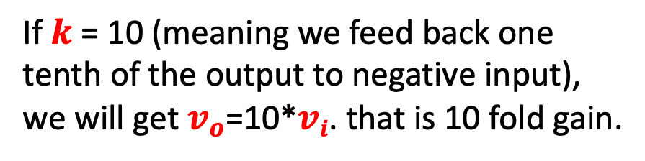
Negative Feedback – Derivation of Gain
Here, $v_{−}=\frac{ν_{0}}{k}$
We know, $v_{o}=Av_{d}$
or, $v_{o}=A{(v}_{+}−v_{−})$
$$=A{(v}_{i}−\frac{ν_{0}}{k})$$
$$=Av_{i}−\frac{A}{k}ν_{0}$$
or, $v_{o}(1+\frac{A}{k})=Av_{i}$
So, $v_{o}=\frac{Av_{i}}{1+\frac{A}{k}}$
or, $v_{o}=\frac{v_{i}}{\frac{1}{A}+\frac{1}{k}}$
$A$ is extremely large,
so, $\frac{1}{A}≈0$
$v_{o}$ $=\frac{v_{i}}{\frac{1}{k}}=kv_{i}$
If $k$ = 10 (meaning we feed back one tenth of the output to negative input), we will get $v_{o}$=10*$vi$. that is 10 fold gain.
How to get 1/k of output to input? Voltage dividers!
$$v_{a}=\frac{1 kΩ}{1 kΩ+9 kΩ}×v_{o}=\frac{v_{o}}{10}$$

Slide 12
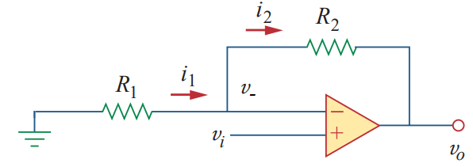

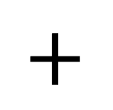
Non-Inverting Amplifier
$$+$$
$$=$$

Slide 13
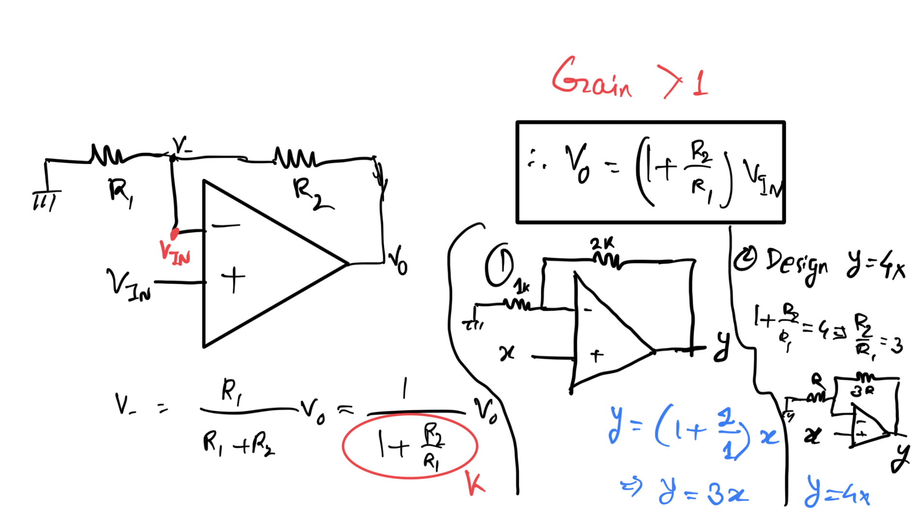
Non-Inverting Amplifier

Slide 14
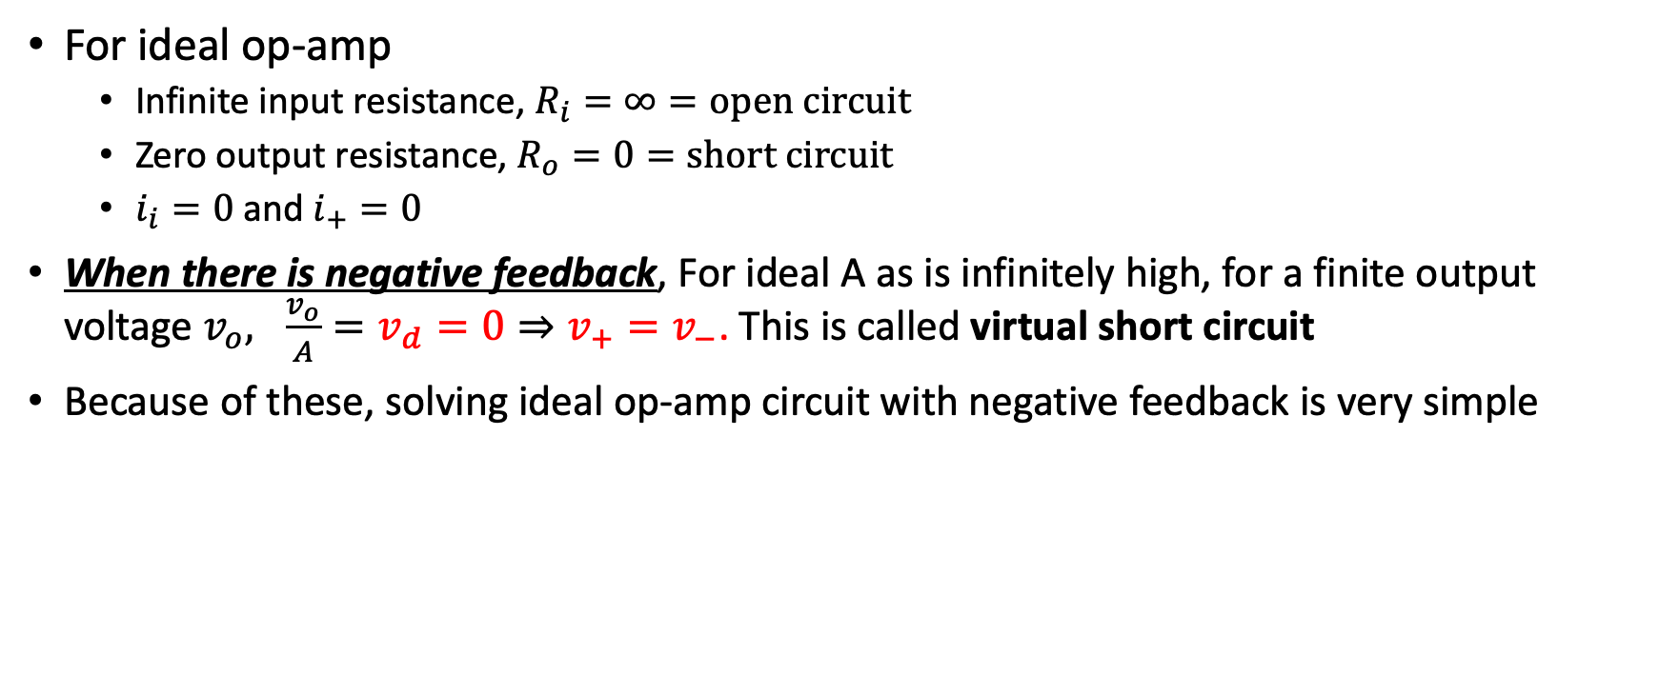
Solving Circuit with Ideal Op Amp + NF
For ideal op-amp
Infinite input resistance, $R_{i}=∞=open circuit$
Zero output resistance, $R_{o}=0=short circuit$
$i_{i}=0$ and $i_{+}=0$
When there is negative feedback, For ideal A as is infinitely high, for a finite output voltage $v_{o}, \frac{v_{o}}{A}={v_{d}=0⇒v}_{+}=v_{−}$. This is called virtual short circuit
Because of these, solving ideal op-amp circuit with negative feedback is very simple

Slide 15
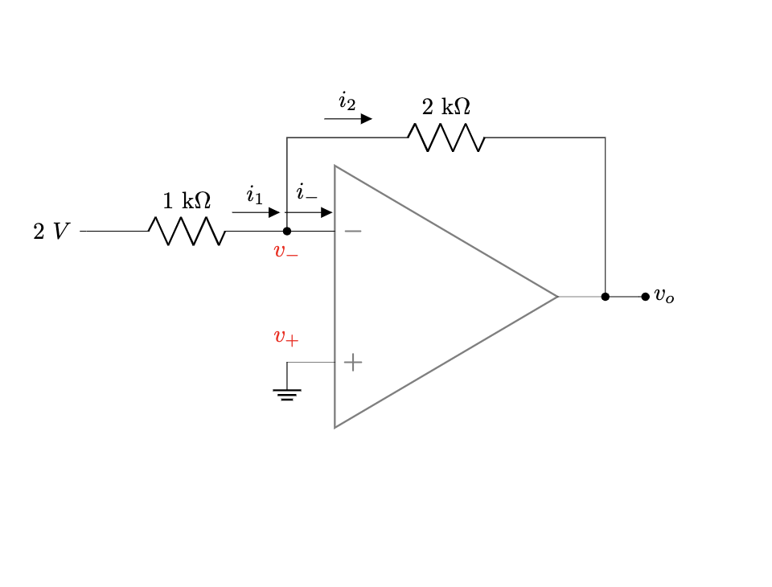
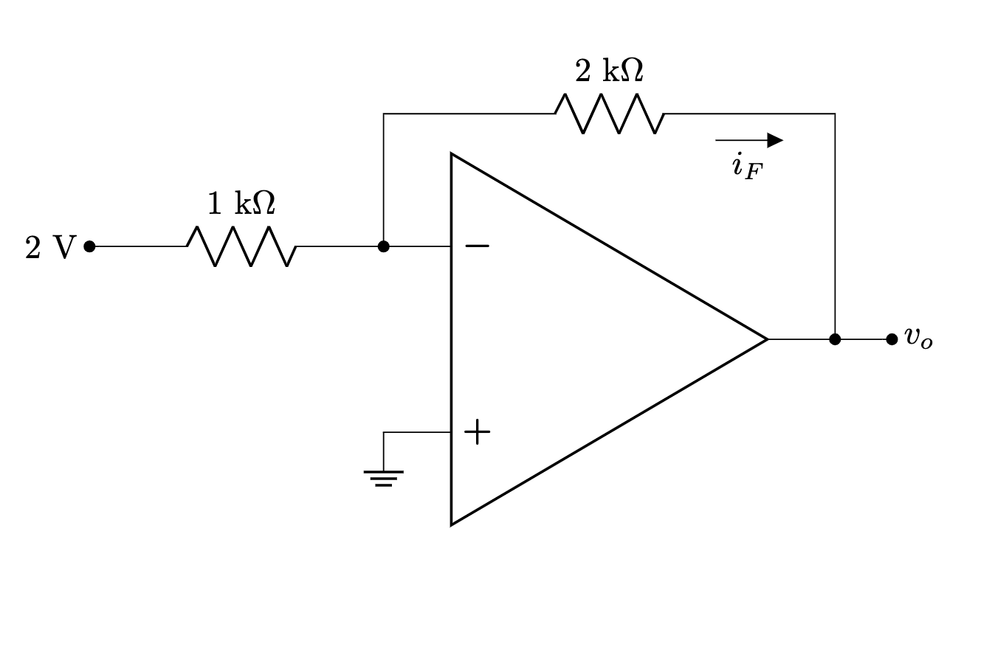
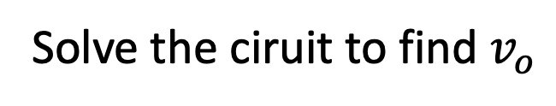
Example – Inverting Amplifier
Solve the ciruit to find $v_{o}$

Slide 16



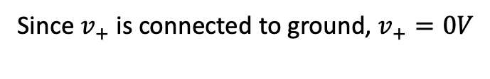

Example – Inverting Amplifier
Since $v_{+}$ is connected to ground, $v_{+}=0V$
Since there is negative feedback, from virtual short, $v_{−}=v_{+}=0V$
Gain = $−\frac{4V}{2V}=−2$ (hence inverting)
From Ohm’s law for $1 kΩ⇒i_{1}=\frac{2V −0V}{1 kΩ}=2mA$
Since ideal op-amp, $i_{−}=i_{+}=0$
From KCL at $v_{−}$, $i_{1}=i_{−}+i_{2}⇒i_{1}=i_{2}=2 mA$
From Ohm’s law for $2 kΩ⇒i_{2}=\frac{v_{−} −v_{0}}{2 kΩ}=2mA⇒v_{o}=−i_{2}×2=−4V$ [ANS]

Slide 17
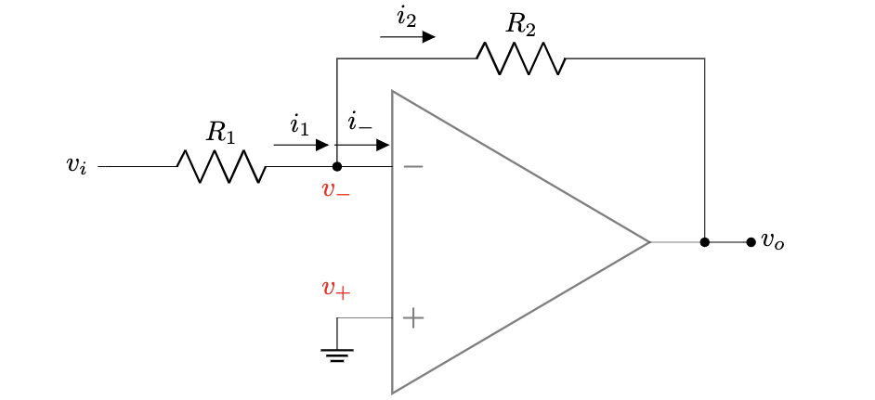


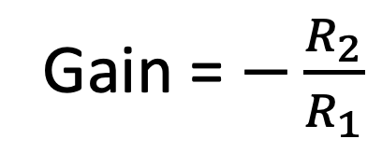
General
Since $v_{+}$ is connected to ground, $v_{+}=0V$
Gain = $−\frac{R_{2}}{R_{1}}$
Since there is negative feedback, from virtual short, $v_{−}=v_{+}=0V$
From Ohm’s law for $R_{1}⇒i_{1}=\frac{v_{i} −0V}{R_{1}}=v_{i}/R_{1}$
Since ideal op-amp, $i_{−}=i_{+}=0$
From KCL at $v_{−}$, $i_{1}=i_{−}+i_{2}⇒i_{1}=i_{2}=v_{i}/R_{1}$
From Ohm’s law for $R_{2}⇒i_{2}=\frac{v_{−} −v_{0}}{R_{2}}=\frac{v_{i}}{R_{1}}⇒v_{o}=−i_{2}×R_{2}⇒v_{o}=−\frac{R_{2}}{R_{1}}v_{i}$ [ANS]

Slide 18
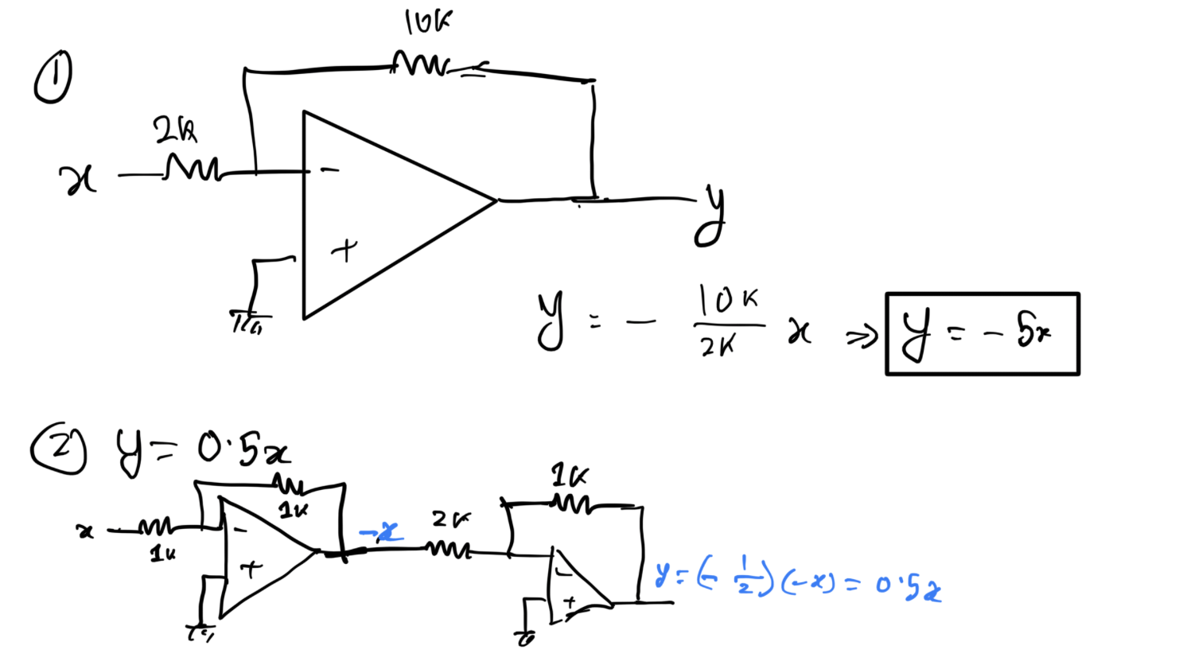
Example

